Slide 1
Bingo Quarterly Reports
Portal Walkthrough
May 2025

Slide 2
https://charitableportal.ohioago.gov/
Enter username and password
OR
If you are a new account user.
Click “Register here.”

Slide 3
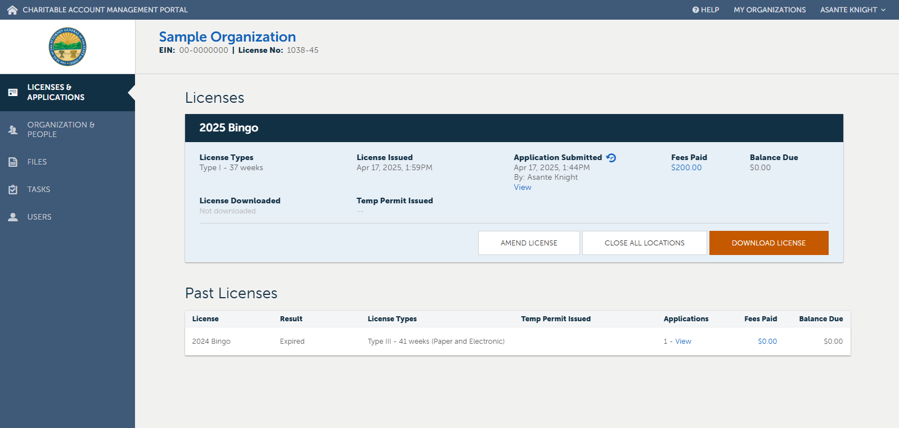
Home Page
Click on the “Files” Tab

Slide 4
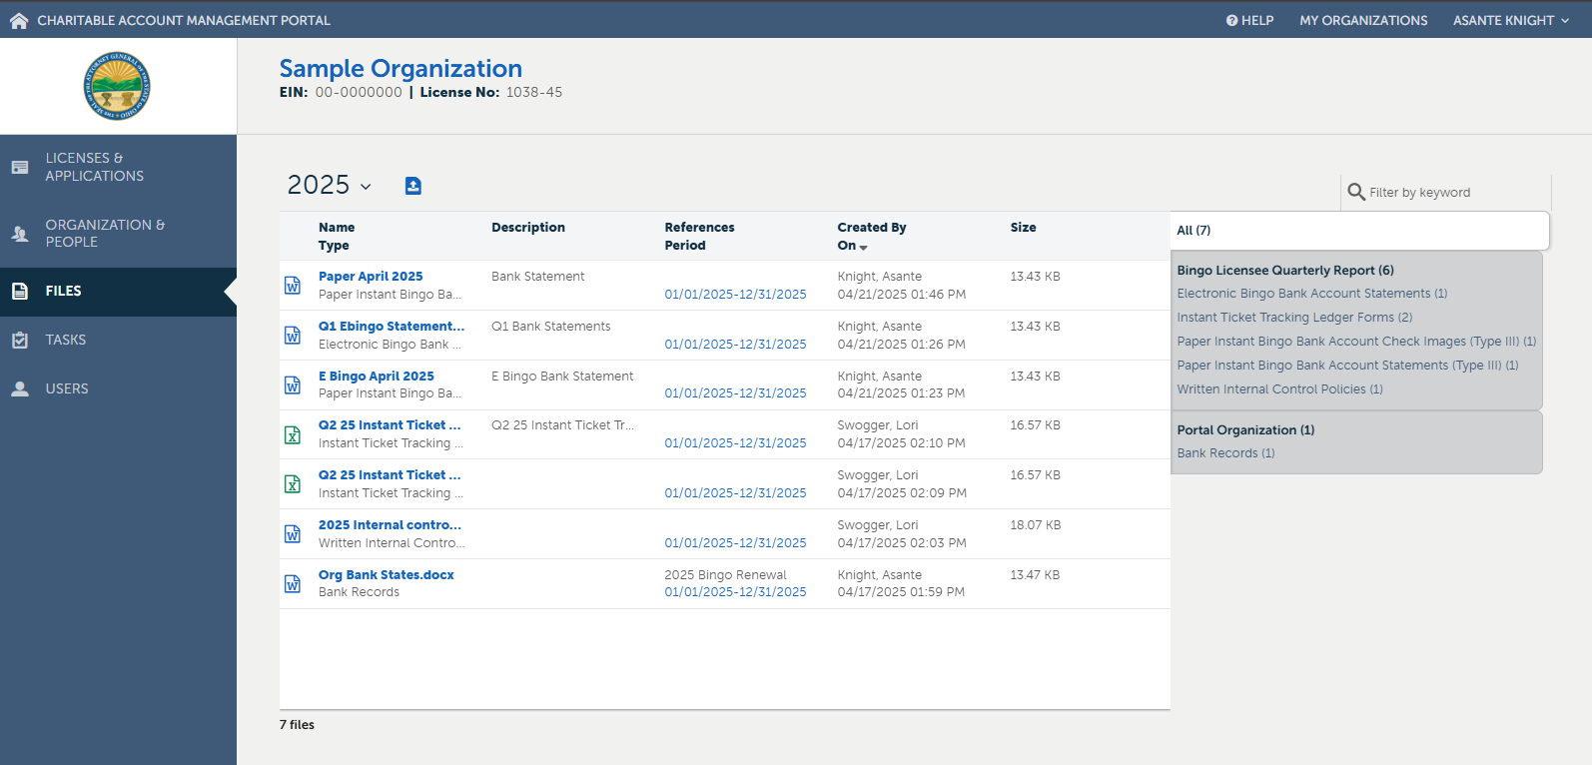
Files Page
Click on the “ ” Icon
NOTE: A current license year will not be available until after a permanent license has been issued to the organization. You may upload a file, without seeing the current license year.

Slide 5
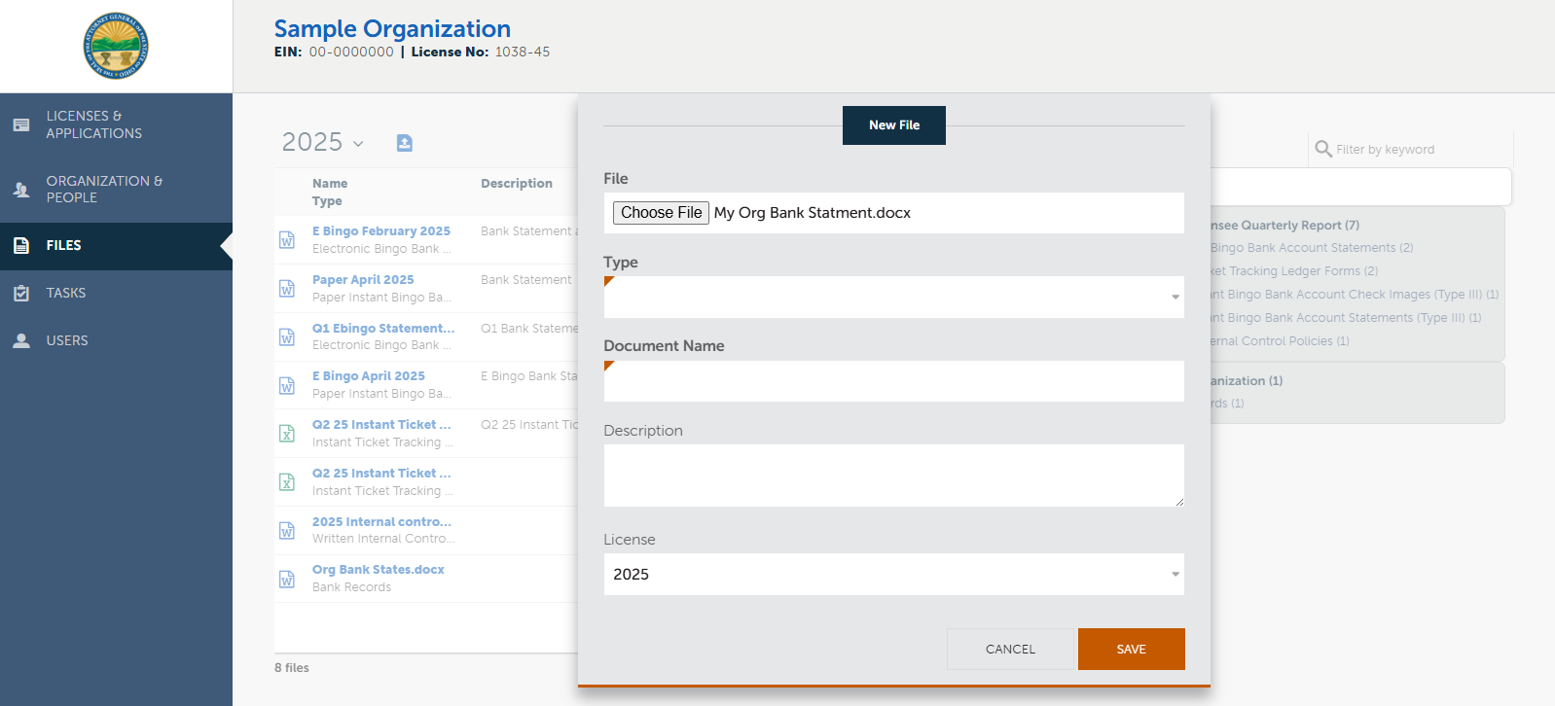
Document Upload
Click “Choose File,” then select the file from your computer.
NOTE: You can only choose one file to upload at a time.

Slide 6
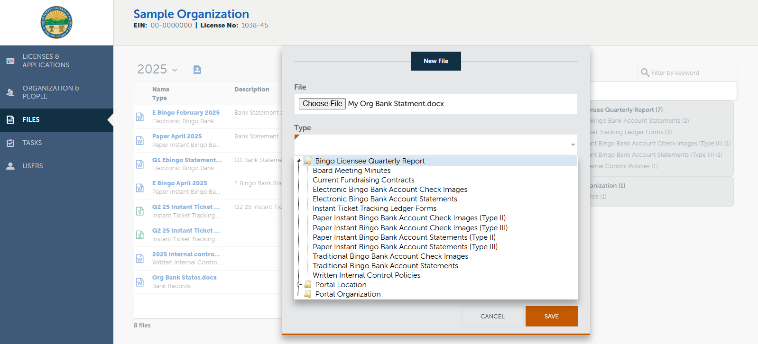
Document Upload
Click on “Bingo Licensee Quarterly Report” from the drop-down list. Then select the corresponding document type.

Slide 7
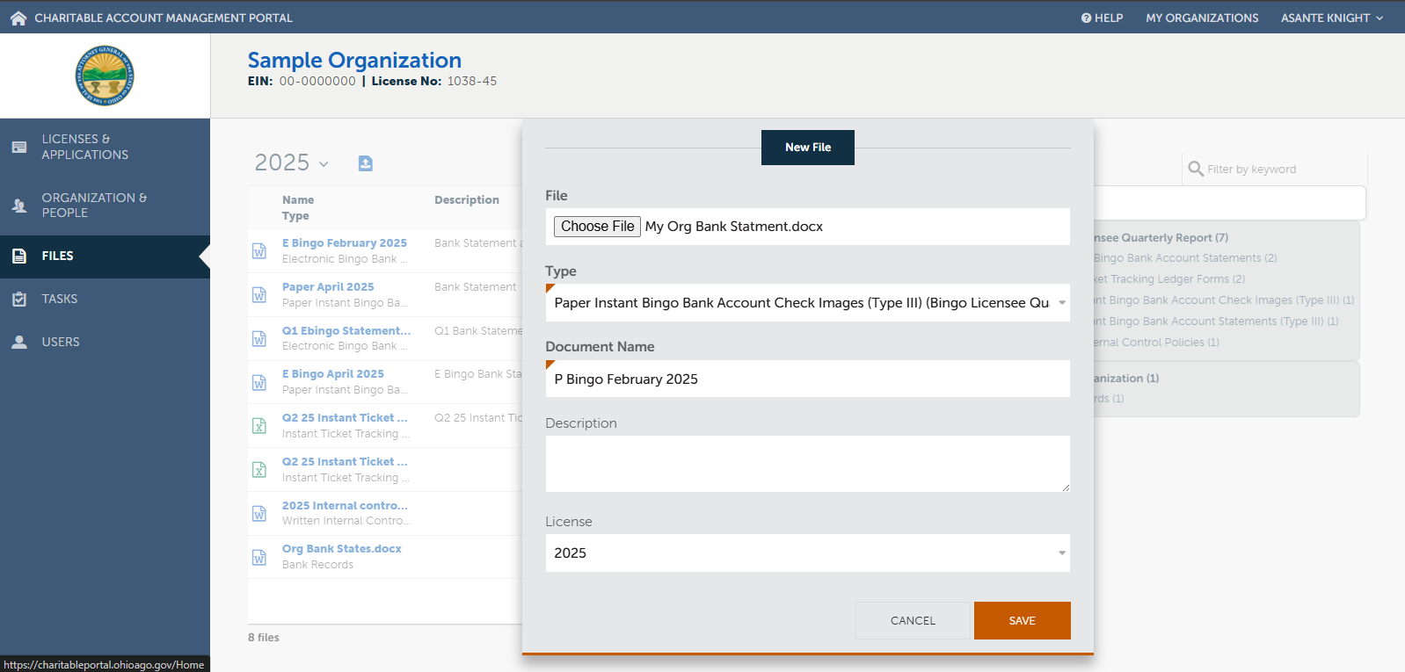
Document Upload
Rename the document using the example as a template.
The document name should include:
Type of Bingo
- (E Bingo or P Bingo)
Month/Quarter of file contents.
Year of file contents.
Changing the document name does not change the file name on your computer.

Slide 8
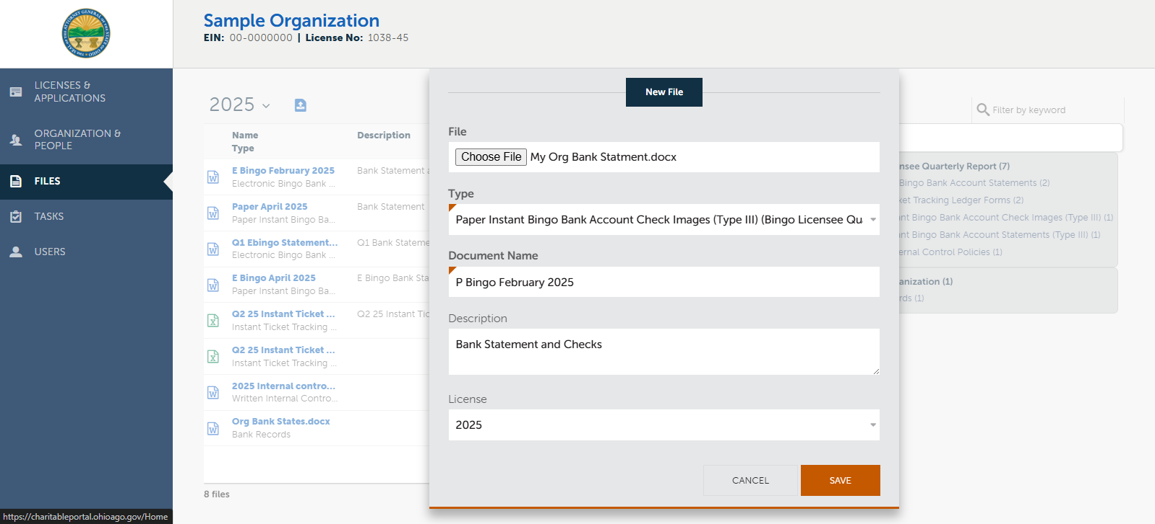
Document Upload
Select the corresponding license year. Remember, you may upload a file without seeing the current license year.
Add a description to further clarify the contents of the file.

Slide 9
Acceptable Document Guide
 | Accepted | NOT Accepted *Any Illegible Document
Bank Statements | Monthly statement issued by your financial institution | Online transaction activity
Check Images | 'Canceled' check image | Check stubs, Photos of uncleared checks, Carbon copy/duplicate checks, Voided checks
Instant Ticket Trackers | Manually completed instant ticket trackers by organization or copies of instant ticket trackers from POS system Please see the attached links: (Excel): https://charitable.ohioago.gov/getattachment/16f2dbc3-c564-475c-b87d-1012e431f07c/Instant-Ticket-Tracker-(Excel) (PDF): https://charitable.ohioago.gov/getattachment/f2f4d7cf-57b9-4bd9-9304-f99b8a10cecb/Instant-Ticket-Tracker-(PDF) | Incomplete instant ticket trackers, POS system summary page, Distributor invoice
Internal Controls Policy | A procedure manual outlining cash handling procedures for all bingo activities | Any form that does not include specific details of your process

Slide 10
Common Questions & Answers
Can I upload more than one month of bank statements at a time?
Yes. The same method applies to cancelled check images and instant ticket trackers.
Can I upload only the checks paid to my contracted charities?
No. All cancelled checks are required to be uploaded.
Do I have to upload my bank statement and check images separately if the bank combines them?
No. Just state “bank statement and check” in the description space of the upload.
Can I upload the online transaction activity for the quarter? Won’t this have the same information as the bank statement?
No. The official bank statement is required to be uploaded.

Slide 11
Charitable Law Section
30 E. Broad St. 25th Floor
Columbus, OH 43215
Office: (614) 466-3181
Fax: (614) 466-9788

